Slide 1
ECU Communication and Networking
Zach Oakes and Christian West
Advisor Aleksander Malinowski
Sponsored by Komatsu America

Slide 2
Presentation Outline
Introduction
Application of Project
Functional Requirements
Hardware
Topology
Components
Preliminary Testing
Software
Software used
Discovery of Peers
Security/Redundancy
Results
Future Work

Slide 3
Introduction
Goal: Prototype a testing and development platform for CAN communication
Explore new designs to modify the current ECU networks
Introduce more more functionality and increase security
Notes:
Build working prototype of a testing and development platform for CAN communication
*This is early step for a larger project that would enable Komatsu create more accountability to uniquely identify and track every ECU in the field
This is specifically for their Ultra-Class Mining Trucks
Our aim was to
Explore new designs to modify the current ECU networks
To Introduce more more functionality and increase security

Slide 4
Application of Project
Purpose as a Testing Platform
Discover faults
Resolve bugs
Prevent liability
Purpose as a Development Platform
Software development to increase functionality and security
Environment for validation
Notes:
Testing and development platform or Testbench
Hardware setup and virtual environment to recreate the CAN communication found in a vehicle in the Automotive and Transportation Industries
Few reasons why this is useful
Discover faults
Resolve bugs
Prevent liability
As a development Platform
Software development to increase functionality and security
Environment for validation

Slide 5
Functional Requirements
Hardware:
Low-cost and easily-repurposable
Simulate a CAN network of ECU’s utilizing master slave topology
Software:
Obtain each module’s ID number
Retain information and software features
Update newly authorized modules and reject those unauthorized
Determine a way to make this communication secure
Notes:
Hardware
Design and create a low-cost and easily-repurposable testing and development platform relating to CAN communication.
Simulate the CAN network of ECU’s with a master slave topology which will be shown later
Software
Make sure that master is capable of tracking the other ECUs on the network
Retain information if the network were to power off
Update new modules that are authorized and reject those that are not
Determine a way to make this communication secure

Slide 6
Presentation Outline
Introduction
Application of Project
Functional Requirements
Hardware
Topology
Components
Preliminary Testing
Software
Software used
Discovery of Peers
Security/Redundancy
Results
Future Work

Slide 7
Diagram of CAN network
ECU: Master
ECU: Slave 2
ECU: Slave 4
ECU: Slave 1
ECU: Slave 3
ECU: Slave 5
120 Ω
120 Ω
Twisted Wires
Notes:
Communication type that allows different devices to talk to each other on the same network without a host computer
Simple yet robust design
Requires only one twisted pair reducing the amount of harnessing needed and weight
This twisted pair is called the CAN Backbone-connected in parallel
120 Ohm resistors.. 60 Ohm across CAN_H and CAN_L
Peer to peer or broadcast-any message sent to the network can be seen by any other module
Master-Slave topology is not required for CAN Communication, however, we used this because it mirrors our software implementation

Slide 8
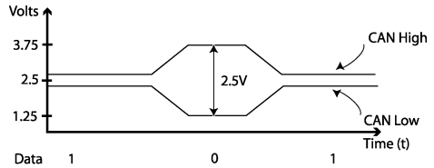
CAN Bus Communication
Notes:
In this diagram, you can see the top line as CAN_H and bottom line as CAN_L
In it’s recessive state, these are kept close to each other at about 2.5V (logical 1)
When a device wishes, pull a part to the dominant state (logical 0)
Any device may assert dominant to write to the network
Keep in mind message Priority is embedded in this communication-
allowing multiple devices to talk

Slide 9
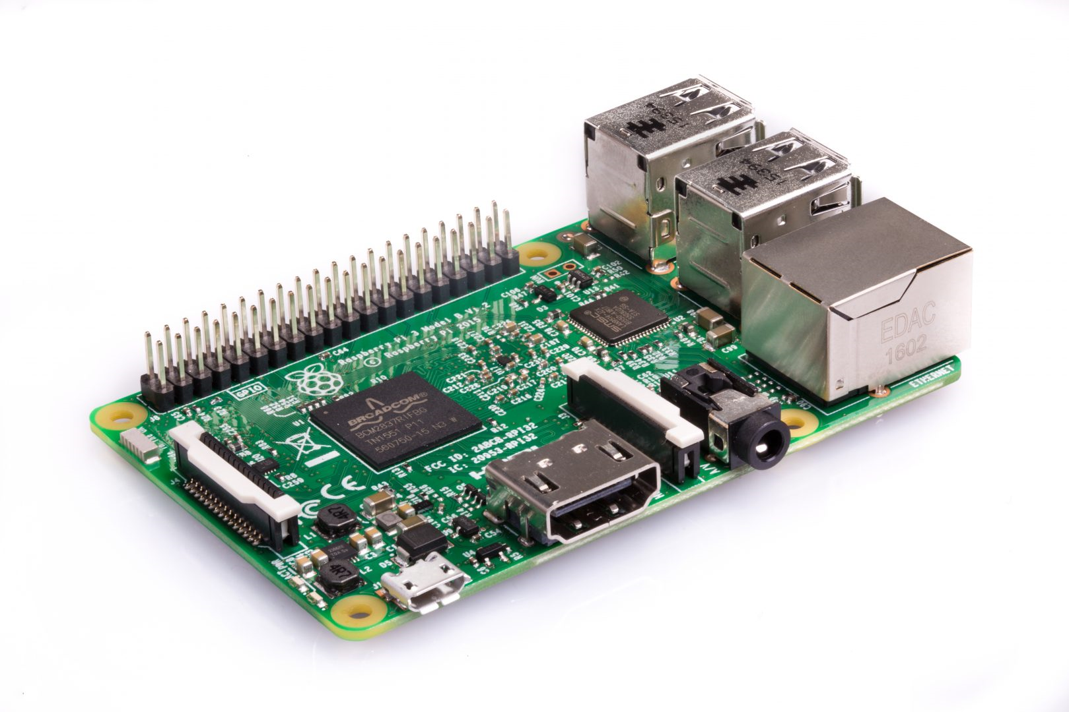
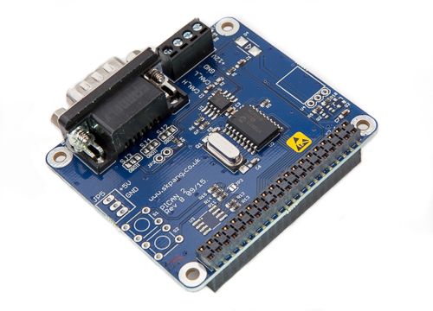
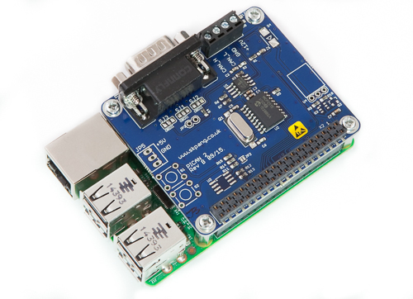
Hardware
Raspberrypi + PiCAN2 = Simulated ECU
Notes:
Rpi cannot easily interface with a CAN network
PiCAN2 created by Copperhill Technology comes with some drivers: Microchip MCP2515 CAN controller with MCP2551 CAN transceiver.
Connection are made via DB9 or 3-way screw terminal.

Slide 10
Hardware
Raspberrypi + PiCAN2 = Simulated ECU
Notes:
Standard DB9 connector

Slide 11
Hardware
Raspberrypi + PiCAN2 = Simulated ECU
Notes:
We made use of the 3-way screw terminal

Slide 12
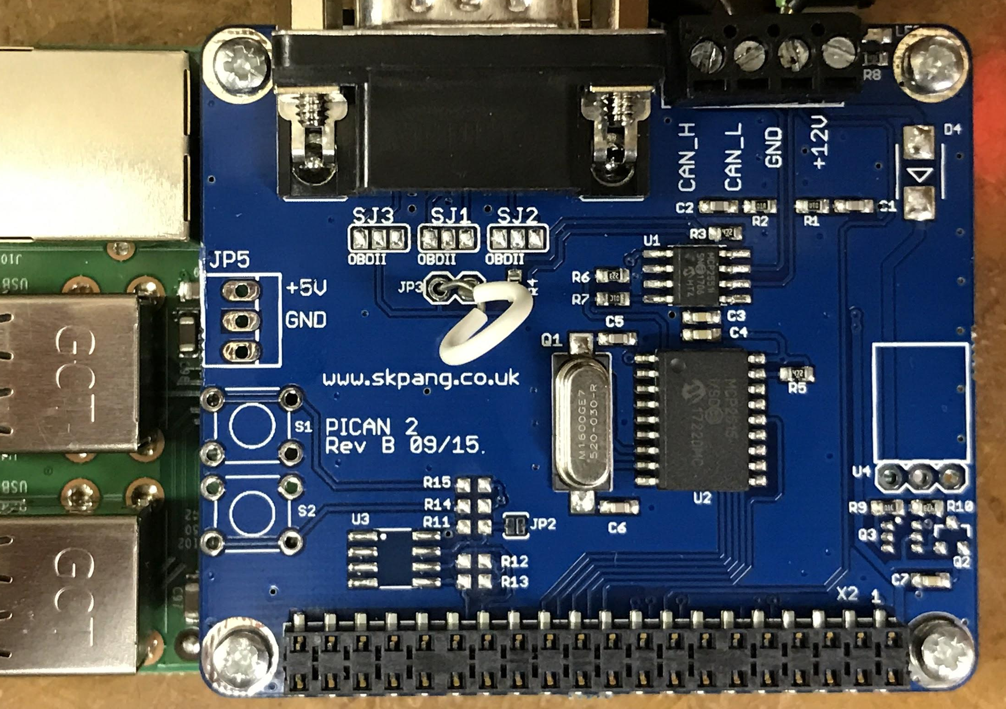
Hardware

Slide 13
Hardware
Notes:
For the Termination resistance we can bridge these pins

Slide 14
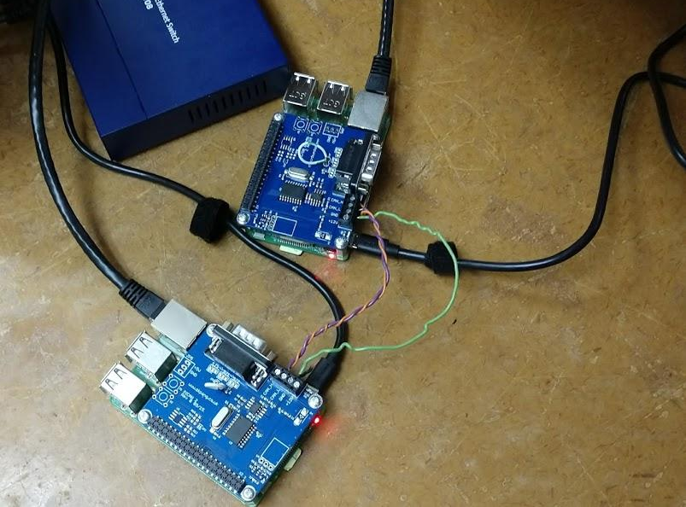
Preliminary Testing
Notes:
Before purchasing all the components we validated this approach

Slide 15
Preliminary Testing
Notes:
In yellow is where we bridged for termination resistance
Twisted pair for CAN is in Red
The switch in the screenshot was used so that we may communicate via a laptop

Slide 16
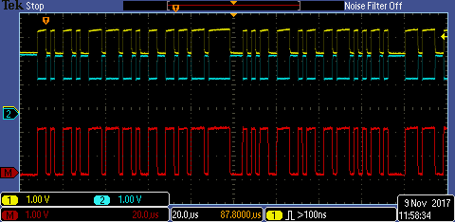
CAN Bus Communication
Notes:
At the top
Yellow probe is CAN_H
Blue is CAN_L
Kept in the recessive state or logical 1
Before being driven apart into the dominant state
Bottom
Packet capture, data was 123#456789abcdef0123

Slide 17
CAN Bus Communication
Notes:
Header containing the start-of-frame and Identifiers
Packet capture, data was 123#456789abcdef0123
Start-of-frame 1 Denotes the start of frame transmission
Identifier (green) 11 A (unique) identifier which also represents the message priority
Remote transmission request (RTR) (blue) 1 Must be dominant (0) for data frames and recessive (1) for remote request frames (see Remote Frame, below)
Identifier extension bit (IDE) 1 Must be dominant (0) for base frame format with 11-bit identifiers
Reserved bit (r0) 1 Reserved bit. Must be dominant (0), but accepted as either dominant or recessive.
Data length code (DLC) (yellow) 4
Number of bytes of data (0–8 bytes)^{[a]}
Data field (red) 0–64 (0-8 bytes) Data to be transmitted (length in bytes dictated by DLC field)
CRC 15 Cyclic redundancy check
CRC delimiter 1 Must be recessive (1)
ACK slot 1 Transmitter sends recessive (1) and any receiver can assert a dominant (0)
ACK delimiter 1 Must be recessive (1)
End-of-frame (EOF) 7 Must be recessive (1)

Slide 18
CAN Bus Communication
Notes:
Packet capture, data was 123#456789abcdef0123
The rest is of the body

Slide 19
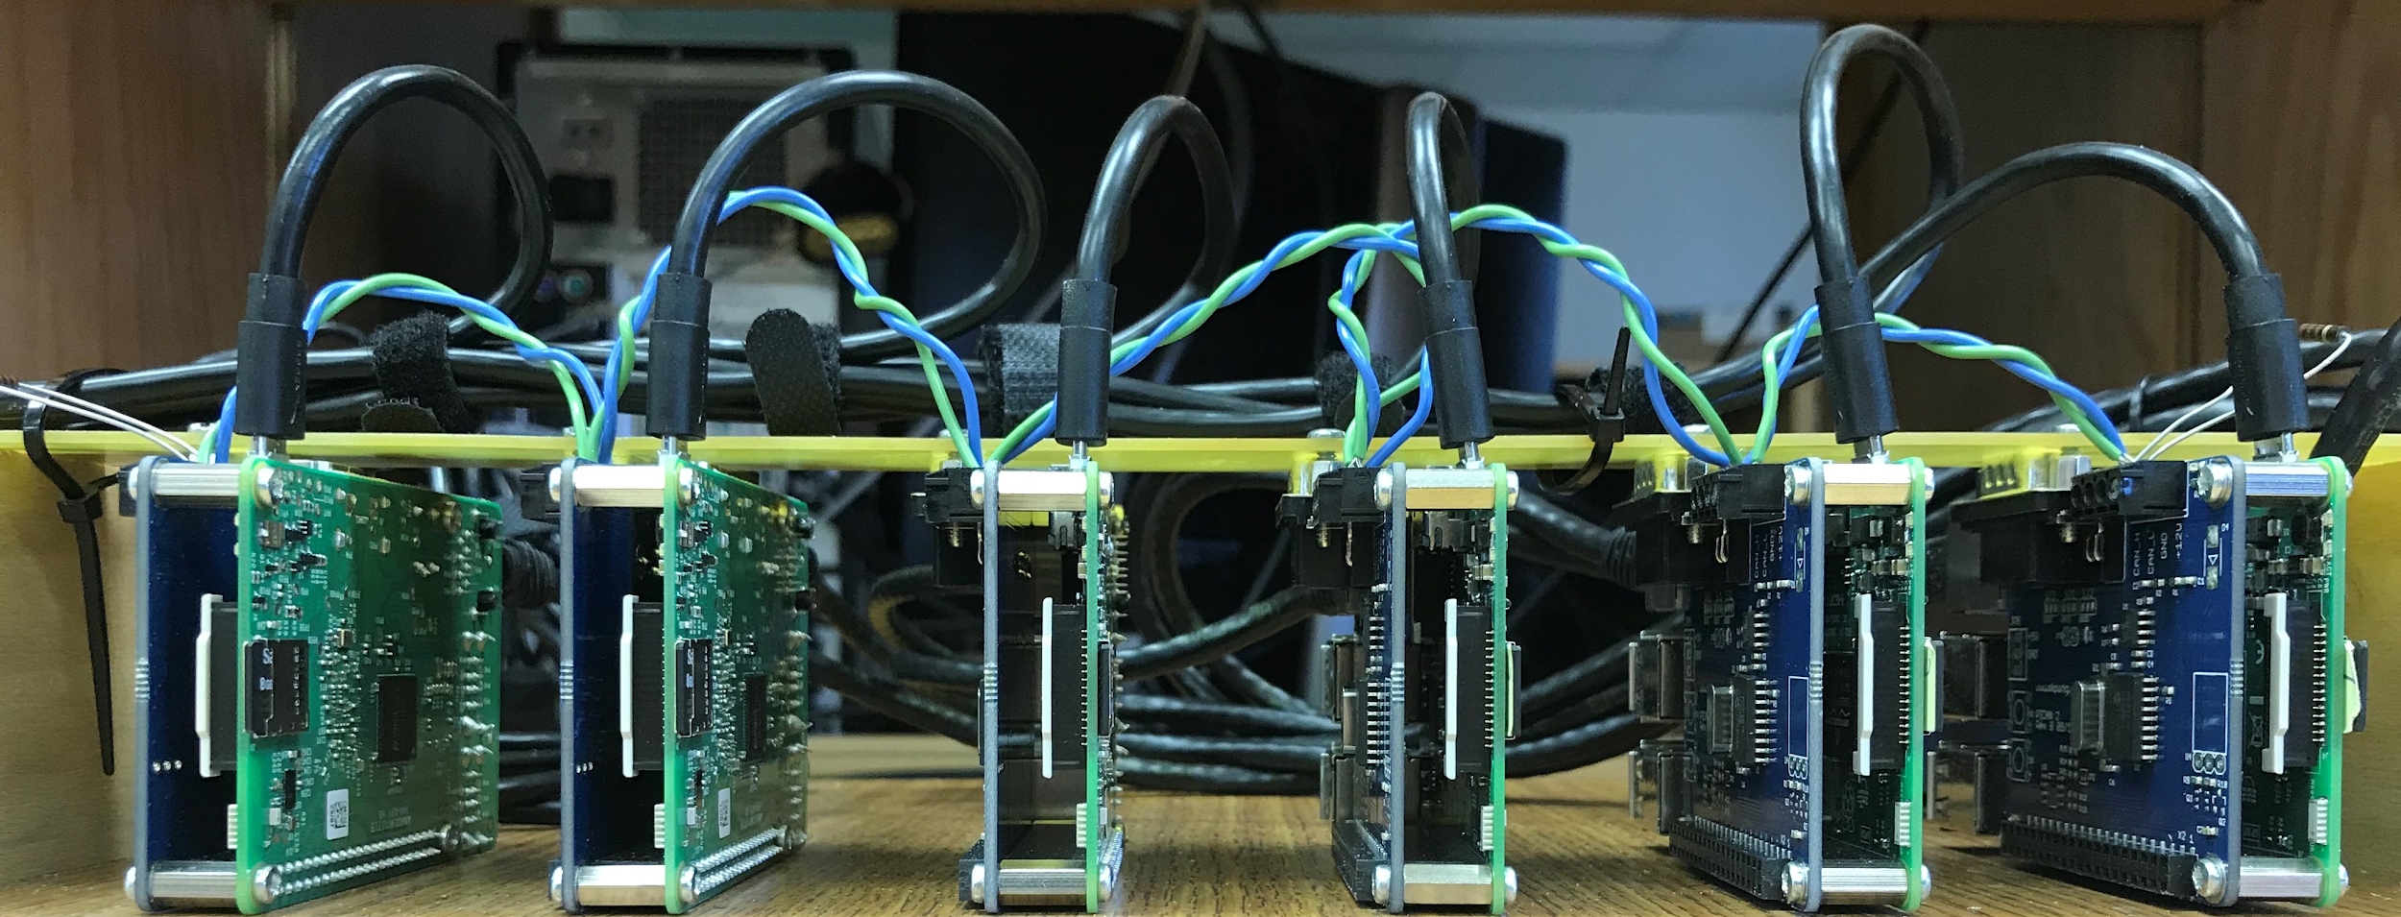
Hardware
Notes:
Expanded Network

Slide 20
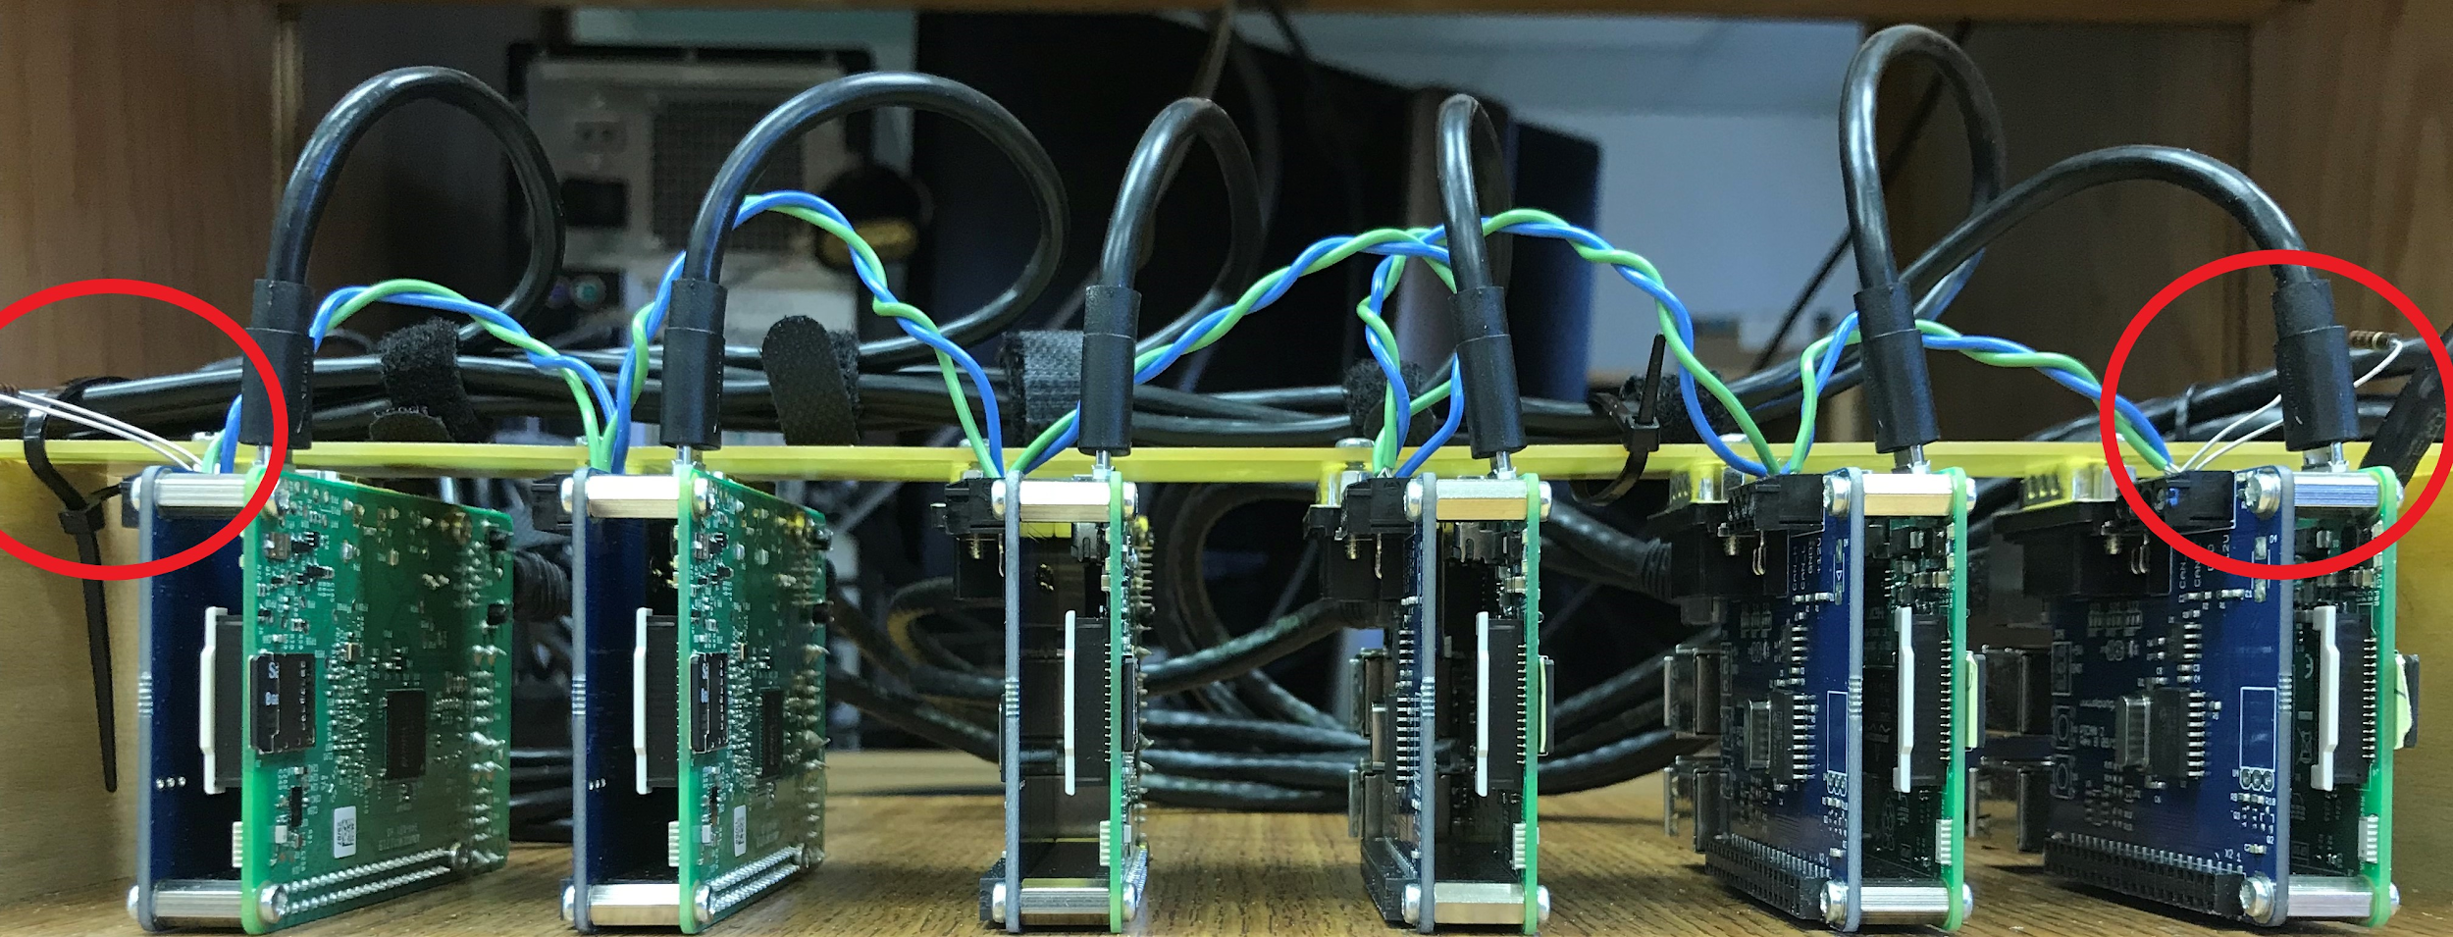
Hardware
Notes:
In red we moved to use actual resistors rated at about 120 Ohms +-10%
Blue Wire is CAN_H
Green Wire is CAN_L

Slide 21
Hardware

Slide 22
Hardware

Slide 23
Hardware
Notes:
SD cards Flashed Raspbian
This allows us to replace SD card to simulate the swapping of entire ECUs without meddling with hardware

Slide 24
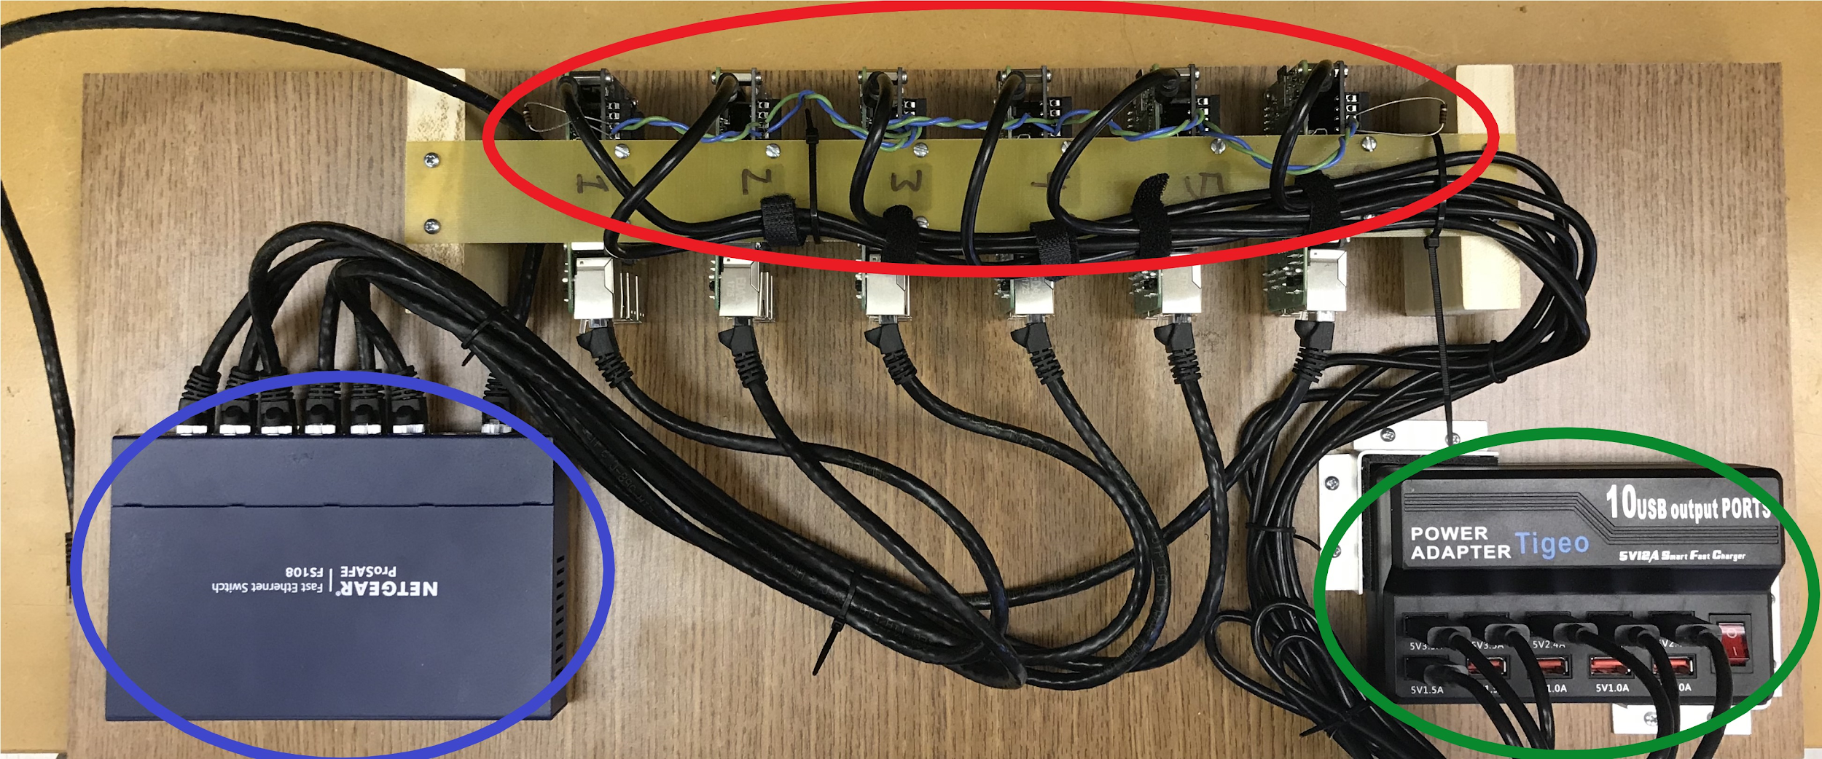
Hardware
Notes:
Entire Platform

Slide 25
Parts List
Quantity | Description | Price | Ext. Price
6 | Raspberry Pi3 Model B | $35.10 | $ 210.60
12 | 8GB micro SD cards | $7.11 | $ 85.32
6 | CAN Interface for Raspberry Pi | $47.95 | $ 287.70
1 | USB HUB for Power | $23.99 | $ 23.99
1 | 3 foot USB 2.0 (6 Pack) | $8.99 | $ 8.99
1 | Ethernet Switch | $23.28 | $ 23.28
1 | Ethernet Cables 2 Feet (10 pack) | $13.99 | $ 13.99
 |  | Total | $ 653.87

Slide 26
Presentation Outline
Introduction
Application of Project
Functional Requirements
Hardware
Topology
Components
Preliminary Testing
Software
Software used
Discovery of Peers
Security/Redundancy
Results
Future Work

Slide 27
Software Used
Raspbian 4.9.59-v7+
Python 2.7.14
Stock with Raspbian
Added hardbyte’s python-can 2.1.0 library
Git was used for source control
Bitbucket was used for source hosting

Slide 28
Discovery of Peers
All of the devices were given some “self” information
Serial number
Role (Brakes, Hydraulics, Engine, etc. )
Nickname (Alice, Bob, Carol, etc)
Master or Slave
The “master” device then iterates through the list of ECUs and asks each one to confirm its information

Slide 29
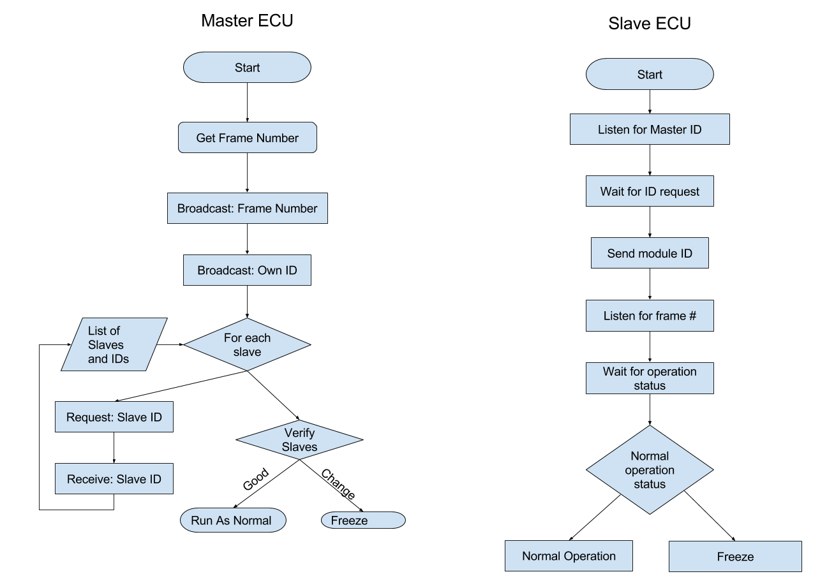
Notes:
Flowcharts showing the proposed control flow for checking the ECU identifiers
Frame number:
Barcode: simple BUT it is subjected to accuracy loss from dirt and requires line of sight
RFID: more secure, more durable, and has a longer range, but more expensive

Slide 30
Notes:
Flowcharts showing the proposed control flow for checking the ECU identifiers
Frame number:
Barcode: simple BUT it is subjected to accuracy loss from dirt and requires line of sight
RFID: more secure, more durable, and has a longer range, but more expensive

Slide 31
Notes:
Flowcharts showing the proposed control flow for checking the ECU identifiers
Frame number:
Barcode: simple BUT it is subjected to accuracy loss from dirt and requires line of sight
RFID: more secure, more durable, and has a longer range, but more expensive

Slide 32
Notes:
Flowcharts showing the proposed control flow for checking the ECU identifiers
Frame number:
Barcode: simple BUT it is subjected to accuracy loss from dirt and requires line of sight
RFID: more secure, more durable, and has a longer range, but more expensive

Slide 33
Notes:
Flowcharts showing the proposed control flow for checking the ECU identifiers
Frame number:
Barcode: simple BUT it is subjected to accuracy loss from dirt and requires line of sight
RFID: more secure, more durable, and has a longer range, but more expensive

Slide 34
Notes:
Flowcharts showing the proposed control flow for checking the ECU identifiers
Frame number:
Barcode: simple BUT it is subjected to accuracy loss from dirt and requires line of sight
RFID: more secure, more durable, and has a longer range, but more expensive

Slide 35
Notes:
Flowcharts showing the proposed control flow for checking the ECU identifiers
Frame number:
Barcode: simple BUT it is subjected to accuracy loss from dirt and requires line of sight
RFID: more secure, more durable, and has a longer range, but more expensive

Slide 36
Notes:
Flowcharts showing the proposed control flow for checking the ECU identifiers
Frame number:
Barcode: simple BUT it is subjected to accuracy loss from dirt and requires line of sight
RFID: more secure, more durable, and has a longer range, but more expensive

Slide 37
Notes:
Flowcharts showing the proposed control flow for checking the ECU identifiers
Frame number:
Barcode: simple BUT it is subjected to accuracy loss from dirt and requires line of sight
RFID: more secure, more durable, and has a longer range, but more expensive

Slide 38
Security
AES Encryption
Block size is larger than packet payload (128 bit)
Key size is minimum 128 bit
Larger memory footprint
Python library depends on compiled C code
Blowfish Algorithm
Block size is the same size as packet payload size (64 bits)
Key size is variable from 32 to >256 bits
No effective cryptanalysis exists
Pure python library available, for a slight loss in performance

Slide 39
Presentation Outline
Introduction
Application of Project
Functional Requirements
Hardware
Topology
Components
Preliminary Testing
Software
Software used
Discovery of Peers
Security/Redundancy
Results
Future Work

Slide 40
Results
Successfully built CAN Testbench from low-cost COTS components
Implemented encryption of network traffic
Verification of networked devices
Dean’s Award at the Student Scholarship Expo

Slide 41
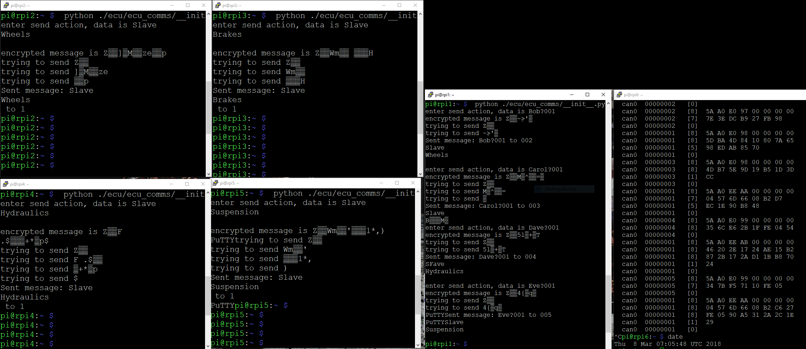
Notes:
This was our testing view

Slide 42
Notes:
This is the data dump window

Slide 43
Notes:
These are the slaves

Slide 44
Notes:
This is the master window

Slide 45
Notes:
Data to be transmitted, showing encryption which is why its garbled

Slide 46
Notes:
Data received after decryption

Slide 47
Presentation Outline
Introduction
Application of Project
Functional Requirements
Hardware
Topology
Components
Preliminary Testing
Software
Software used
Discovery of Peers
Security/Redundancy
Results
Future Work

Slide 48
Future Work
Software implementation
Change XML format of ECU information to something better like JSON
Ship a portable version of the python-can library with our code to reduce setup time
Automatic programming of new devices
Hardware implementation
Add electrical noise and loss to the network
Add a standard DB9 CAN port, so a COTS CAN reader can be plugged into the bus directly

Slide 49
ECU Communication and Networking
Zach Oakes and Christian West
Advisor Aleksander Malinowski
Sponsored by Komatsu America

Slide 51
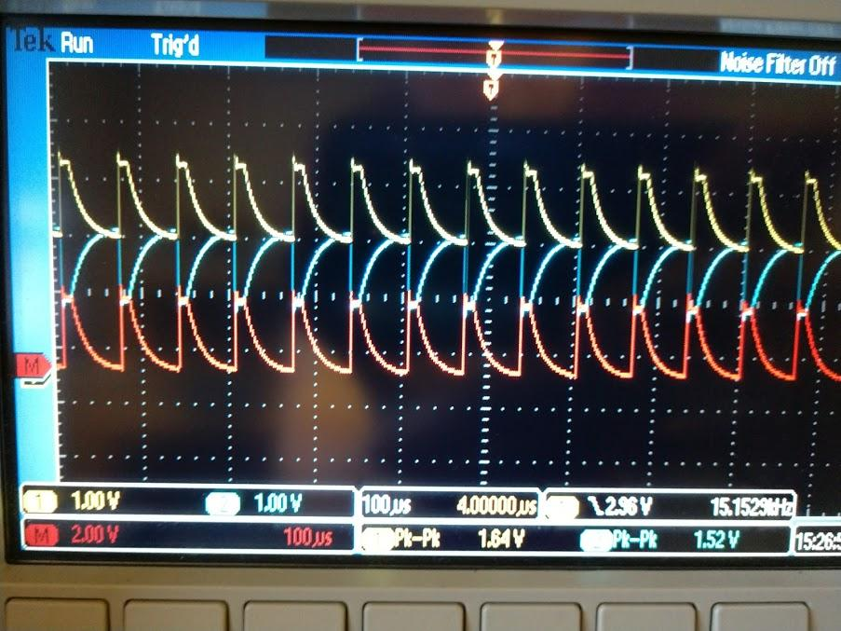

Slide 52
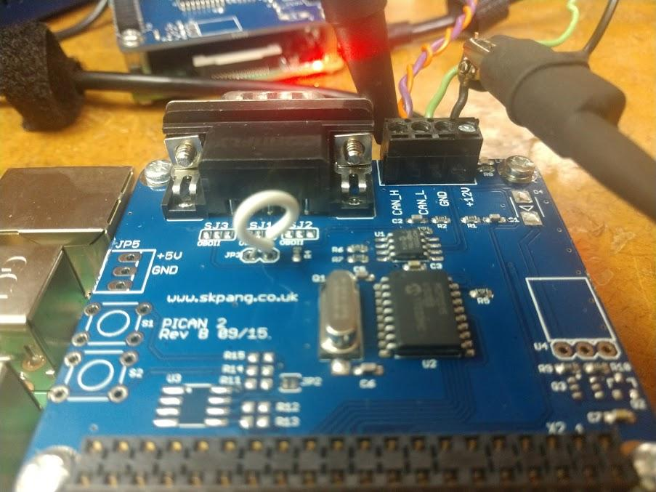

Slide 53
